Slide 1
Changing the Energy Paradigm? the Impact of Fukushima on the future of Nuclear Power
John Saroudis
Regional Vice President
June 28th , 2011
Bucharest, Romania

Slide 2
Outline
Background
CANDU Plant layout
Passive features
EC6 Safety Summary
The impact of Fukushima on future of nuclear power
The role of CANDU

Slide 3
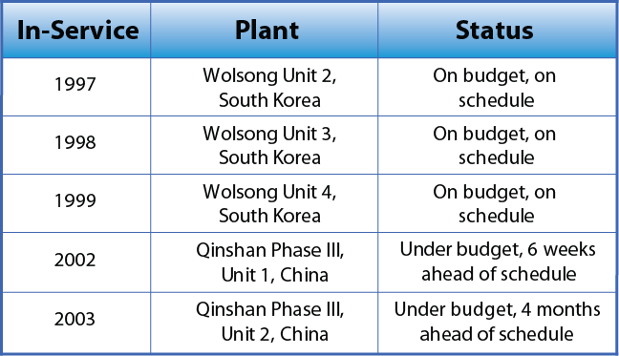
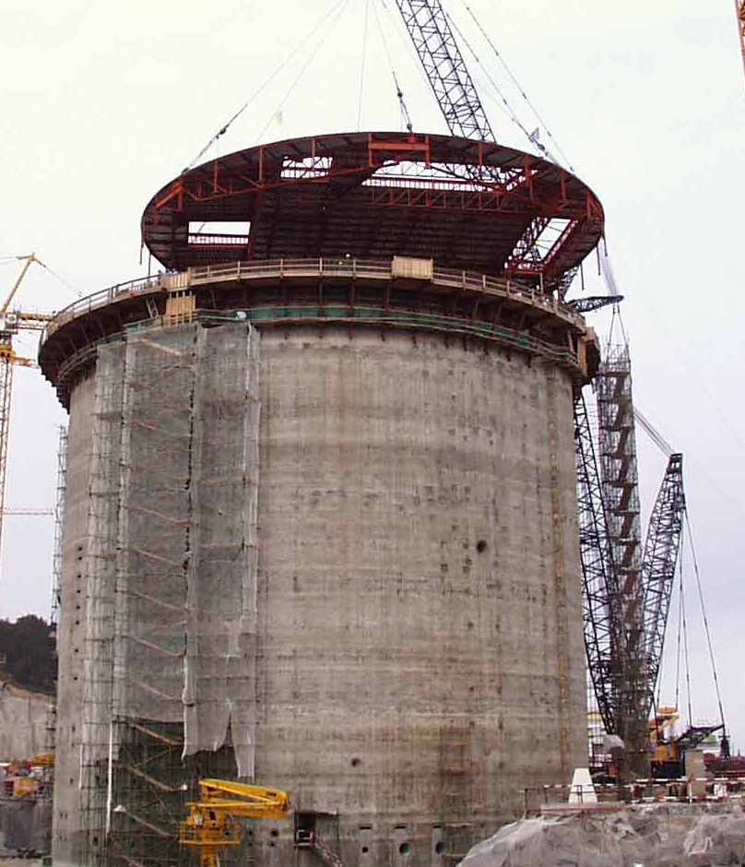
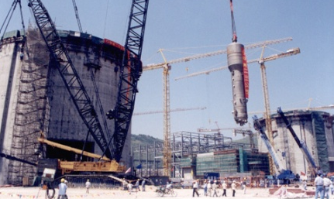
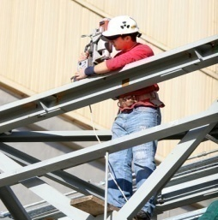
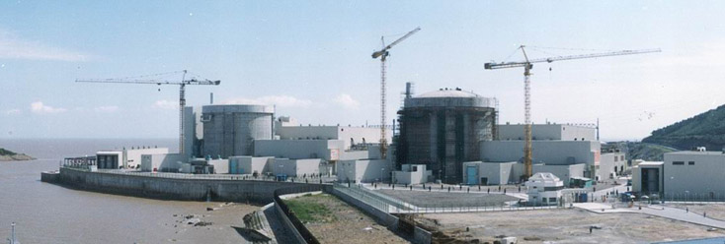
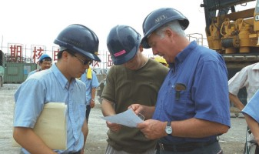
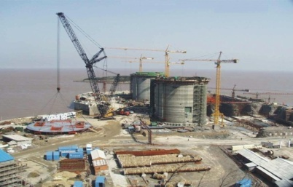
Background
Qinshan Construction
AECL - OFFICIAL USE ONLY / À USAGE EXCLUSIF - EACL

Slide 4
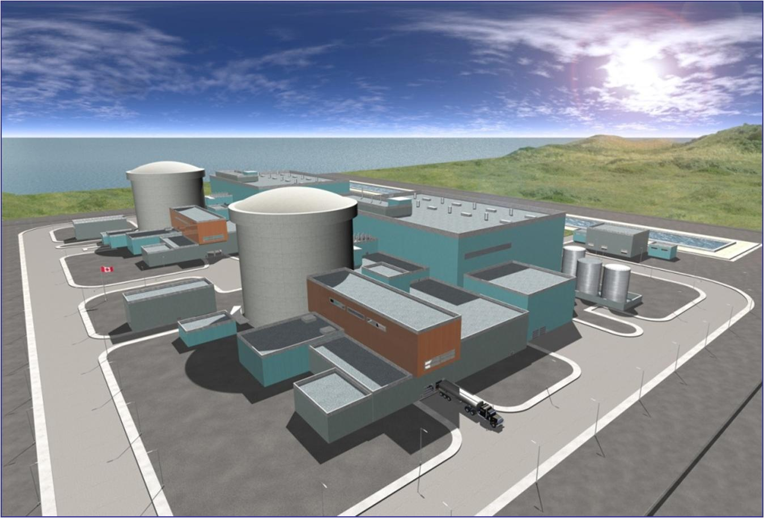
EC6 Reference Plant Layout
Turbine Building
Reactor Building
Secondary Control Area
Standby Diesel Generator
Emergency Diesel Generators
Spent Fuel Bay
Service Building
Severe Accident Diesel Generators
(adjacent to reservoir)
24 hour SQ UPS batteries in SB

Slide 5
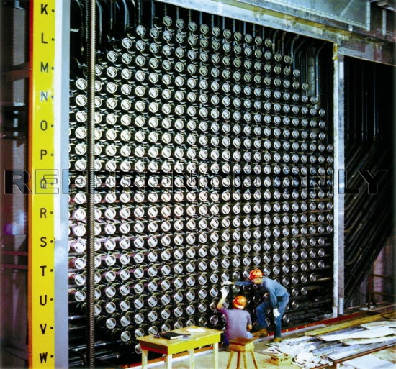
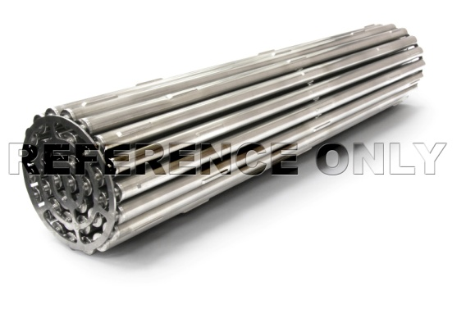
EC6/C6 Design Features
  Natural uranium fuel
  Neutron economy
  Modular, horizontal fuel channel core
  Separate low-temperature and pressure moderator
  On-power refuelling
  Calandria vault filled with light water which surrounds the core
  Two independent passive safety shutdown systems
  Reactor building access for on-power maintenance
Calandria (reactor core)
Fuelling machine
Calandria tube
Fuel bundle
37-element bundle
(20kg / 50cm)
Fuel channel
CANDU 6
Reactor Face

Slide 6
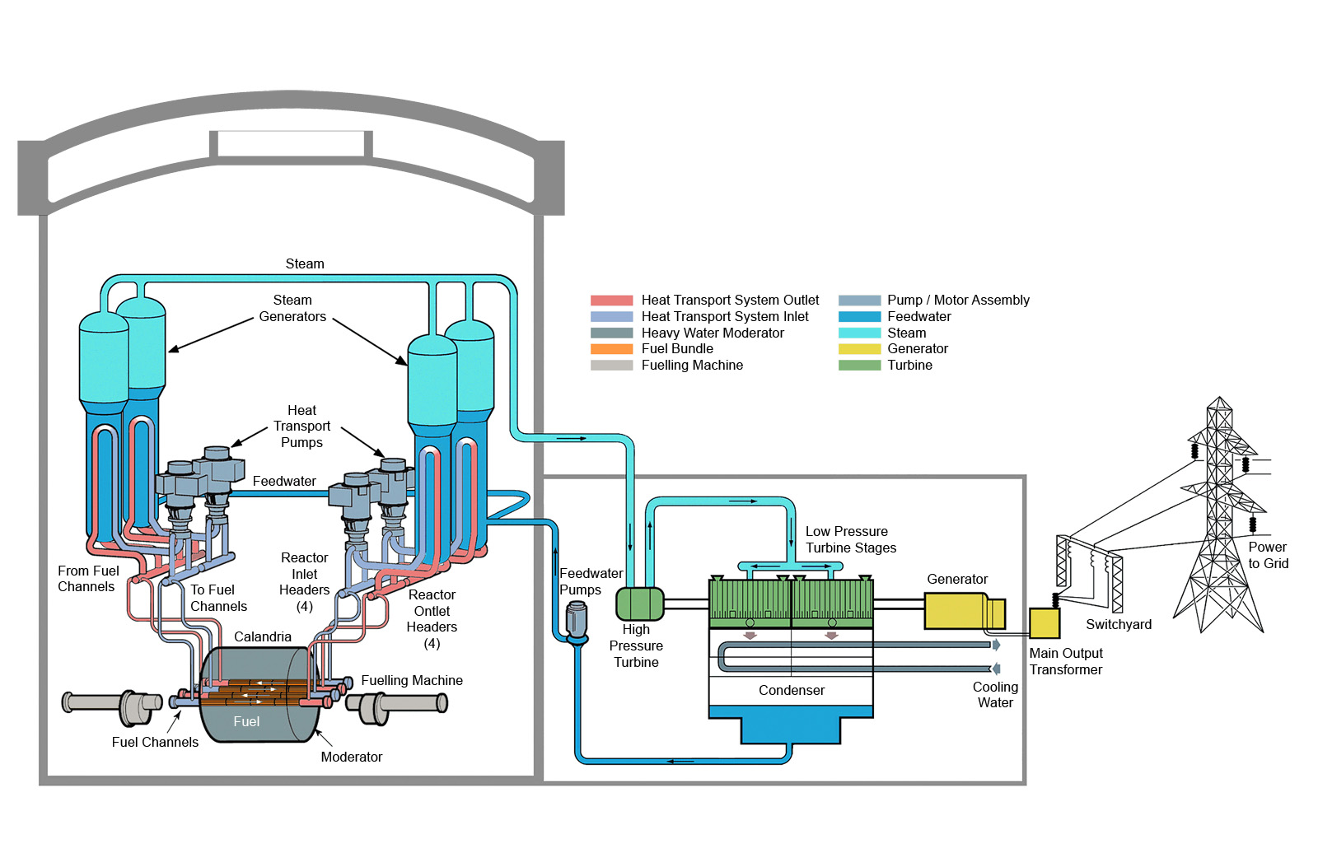
EC6 Schematic

Slide 7
Passive Features
  Passive sources of decay heat removal following reactor shutdown:
190 tonnes heavy water in heat transport system (HTS)
210 tonnes of high pressure emergency core cooling (HPECC)
240 tonnes of heavy water in calandria vessel
520 tonnes of light water in calandria vault
2000 tonnes of light water in reserve water tank (RWT)
AECL - OFFICIAL USE ONLY / À USAGE EXCLUSIF - EACL
7
Notes:
PROTECTED - SENSITIVE /
PROTÉGÉ - DÉLICAT
7

Slide 8
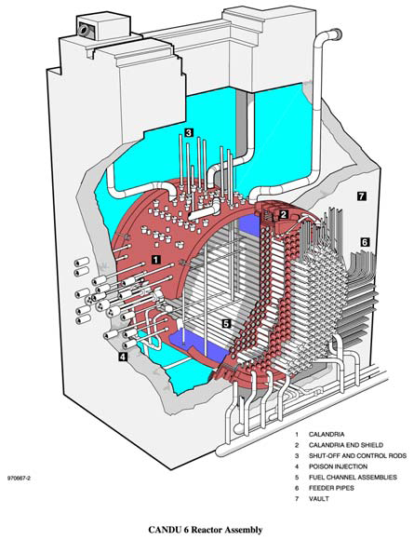
Reactor Core and water inventories as passive features preventing severe accidents
~520 tonnes H²O in Calandria Vault
(10 to 20 hours to heat up and boil off )
~240 tonnes D²O in Calandria Vessel
(> 5 hours to heat up and boil off)
~190 tonnes D²O in Heat Transport System
  Inherent passive sources of decay heat removal following reactor shutdown (part of original CANDU design)

Slide 9
EC6 Thermosyphoning Schematic
RWT under gravity flow into the steam generators can continue to remove decay heat from the fuel in the reactor for three days by thermosyphoning on the primary side
Reserve Water Tank
Automatic opening by UPS power
Connection to EHRS
Secondary side
Heat transfer from primary side to secondary side
MSSVs
Opens automatically
Primary side
Feedwater supply
Heat generated by fission product decay

Slide 10
Loss of Power - Heat Sinks for EC6
 | All electrical power available | Loss of Grid (Loss of Class IV) | Loss of Grid + Stand By Class III Diesels | Loss of AC Generation (Loss of Class IV & Class III & EPS DGs) | Station Black Out (Loss of Class IV/III/II/I & EPS DGs & SARHRS DG)
Available Power Sources | Class IV from Grid Class III Standby Diesels Class I UPS EPS Diesels 24 hour SQ UPS SARHRS Diesel | Class III Standby Diesels Class I UPS EPS Diesels 24 hour SQ UPS SARHRS Diesel | Class I UPS EPS Diesels 24 hour SQ UPS SARHRS Diesel | 24 hour SQ UPS SARHRS Diesel | 24 hour SQ UPS
Available Heat Sinks | Main Feedwater Auxiliary Feedwater Shutdown Cooling Emergency Heat Removal System Moderator System Reserve Water System Shield Cooling Emergency Core Cooling Local air coolers Spent Fuel Bay Cooling Severe Accident Recovery & Heat Removal System (SARHRS) Containment Cooling Spray | Auxiliary Feedwater Emergency Heat Removal System Reserve Water System Shutdown Cooling Moderator System Shield Cooling Emergency Core Cooling SARHRS Containment Cooling Spray Local air coolers Spent Fuel Bay Cooling | Emergency Heat Removal System Reserve Water System Emergency Core Cooling (ECC) SARHRS Containment Cooling Spray Local air coolers NSQ Fire water (diesel driven) | Reserve Water System Severe Accident Recovery & Heat Removal System (SARHRS) Containment Cooling Spray NSQ Fire water (diesel driven) | Reserve Water System High Pressure ECC NSQ Fire water (diesel driven) HTS boil off Moderator boil off Calandria Vault boil off
Amount of heat to be removed | 2,182 MWth (reactor at full power) 1.8MWth (spent fuel bay) | <1% of Full Power after 24 hours (reactor) 1.8MWth (spent fuel bay) | <1% of Full Power after 24 hours 1.8MWth (spent fuel bay boil off) | <1% of Full Power after 24 hours 1.8MWth (spent fuel bay boil off) | <1% of Full Power after 24 hours 1.8MWth (spent fuel bay) boil off)
Timing | Indefinitely | Indefinitely | Indefinitely 13 days (spent fuel bay) | Indefinitely (reactor) 13 days (spent fuel bay) | > 3days (reactor) 13 days (spent fuel bay)

Slide 11
EC6 Safety Summary
Both active and passive systems to prevent severe accidents
Severe accident progression is relatively slow
Robust design against severe accidents
AECL - OFFICIAL USE ONLY / À USAGE EXCLUSIF - EACL
11
Notes:
PROTECTED - SENSITIVE /
PROTÉGÉ - DÉLICAT
11

Slide 12
The Impact of Fukushima on the Future of Nuclear Power
World Population Trends
World Energy Consumption
Are we more efficient?
Do we have a choice?
Nuclear needs to play a role.

Slide 13
Anticipated World Population
2011 October 7 Billion
2050 9 Billion
2100 10 Billion

Slide 14
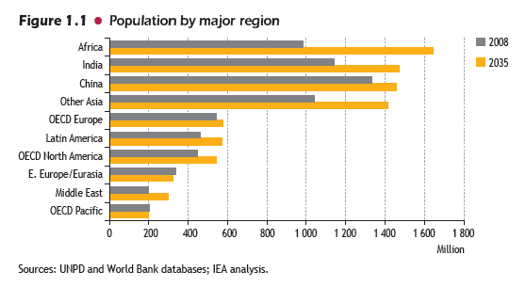
Population Growth in Major Regions
Source: IEA World Energy Outlook 2010

Slide 15
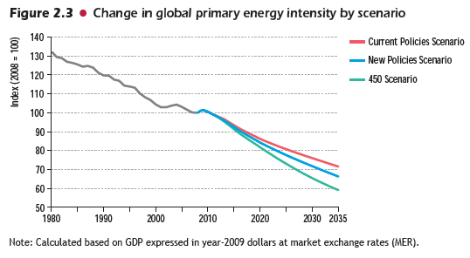
Global Primary Energy Intensity
Source: IEA World Energy Outlook 2010

Slide 16
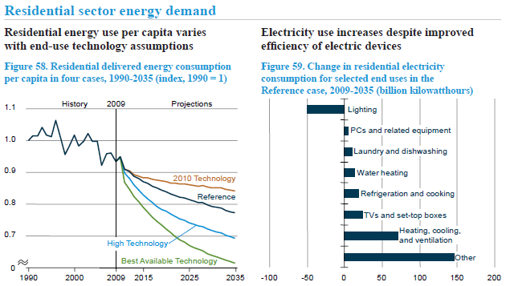
Changes in residential electricity demand:
United States example

Slide 17
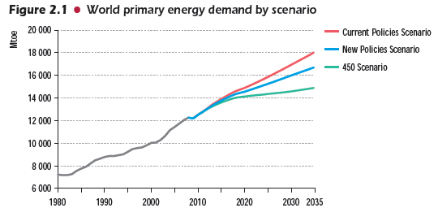
World Overall Primary Energy Demand
Source: IEA World Energy Outlook 2010

Slide 18
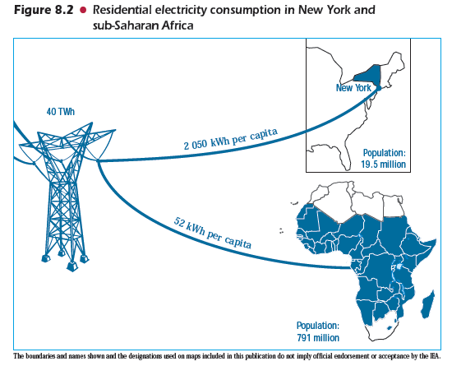
Where electricity consumption growth will come from
Source: IEA World Energy Outlook 2010

Slide 19
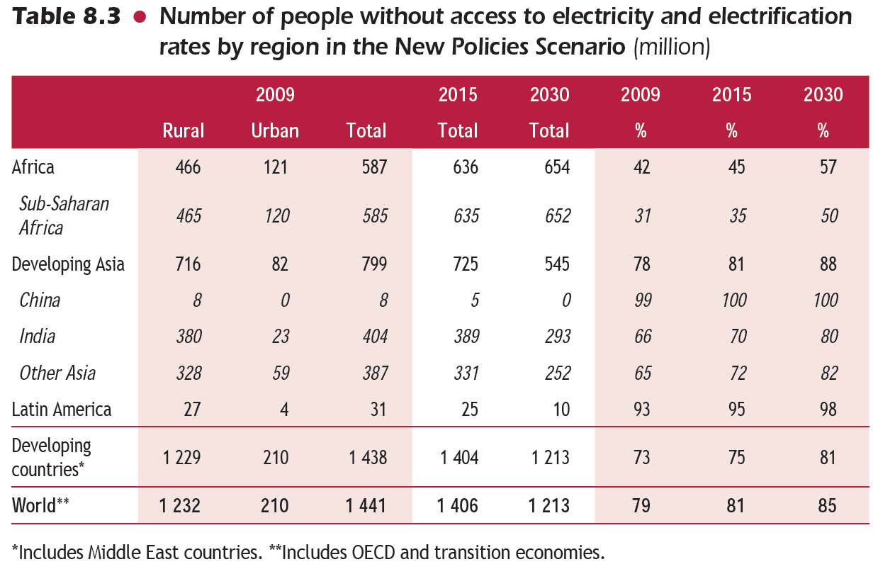
Electrification of developing regions
Source: IEA World Energy Outlook 2010

Slide 20
Meeting Future Energy Needs
Energy needs will rise with electricity leading the way;
With current policies in many countries renewables will play a key role but up to a point; cost considerations will soon take over;
Abundance of relatively inexpensive coal and gas will make them key players in electricity generation (growing evidence of climate change will become a factor longer term that will curtail their use);
Nuclear will continue to grow; some slowdown expected in certain countries; BUT economics will be a key factor: nuclear will be successful in markets where it is competitive (e.g. China)

Slide 21
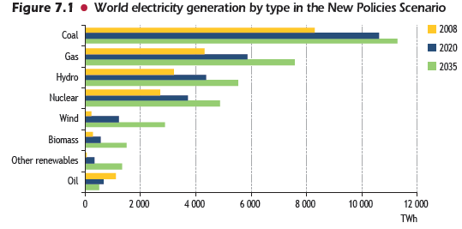
World Electricity Generation to 2035
Source: IEA World Energy Outlook 2010

Slide 22
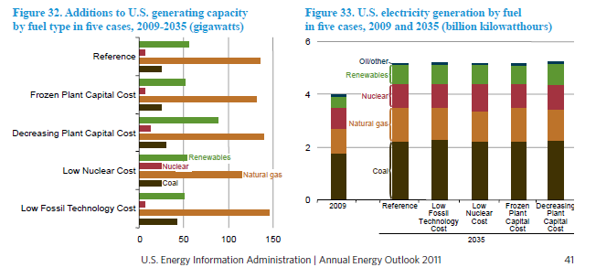
U.S. Generating Capacity to 2035

Slide 23
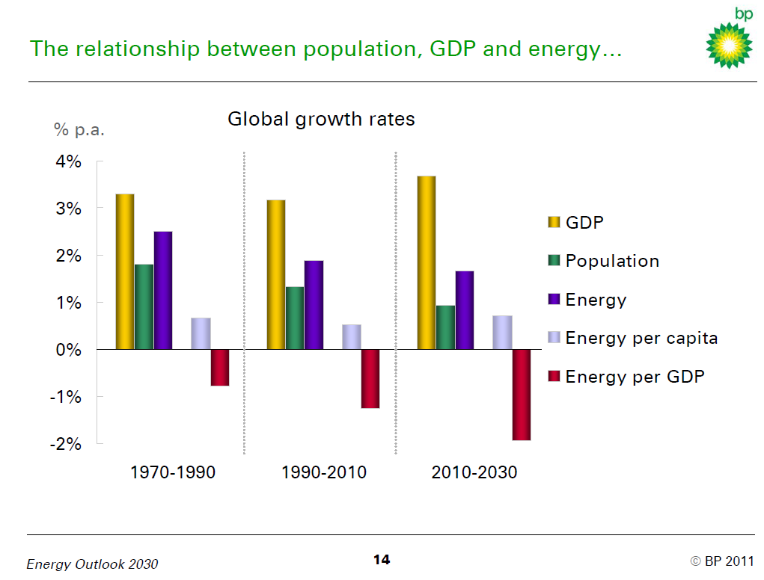
Where we were….. Where we are going…..

Slide 24
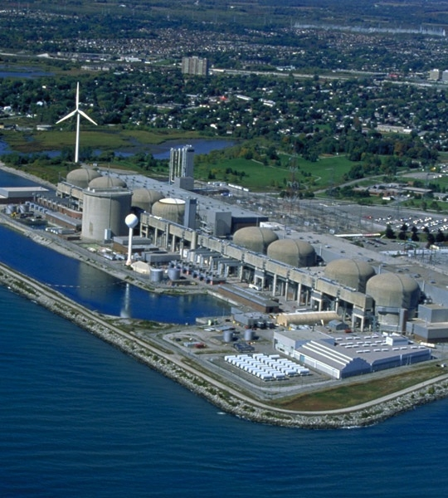
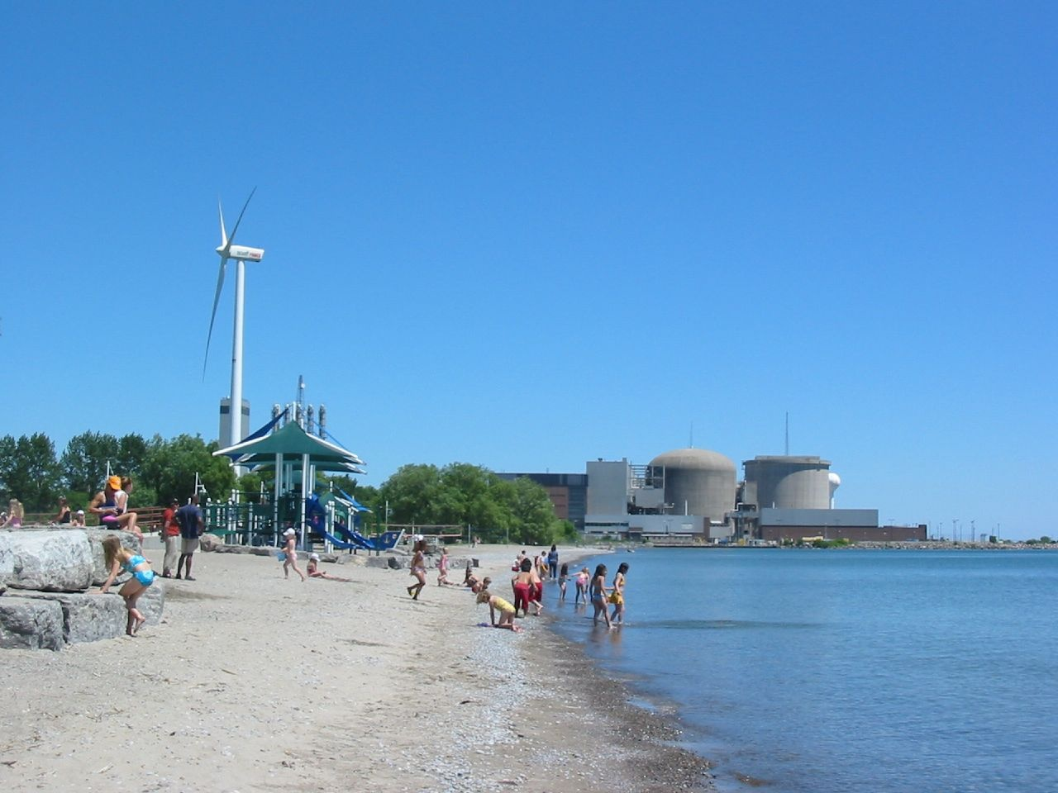
Nuclear Power – Part of our urban landscape
Public acceptance, safety, and close to home.
AECL - OFFICIAL USE ONLY / À USAGE EXCLUSIF - EACL

Slide 25
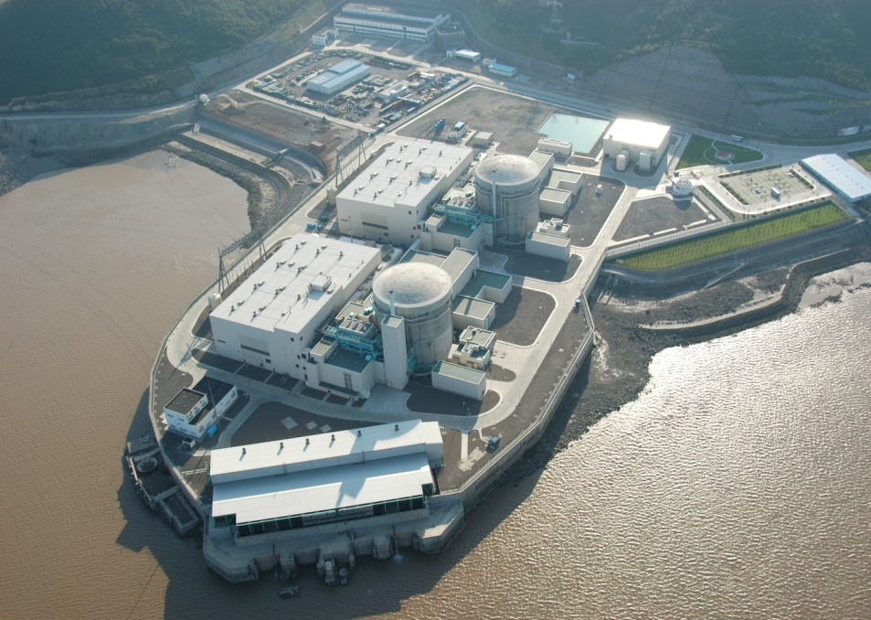
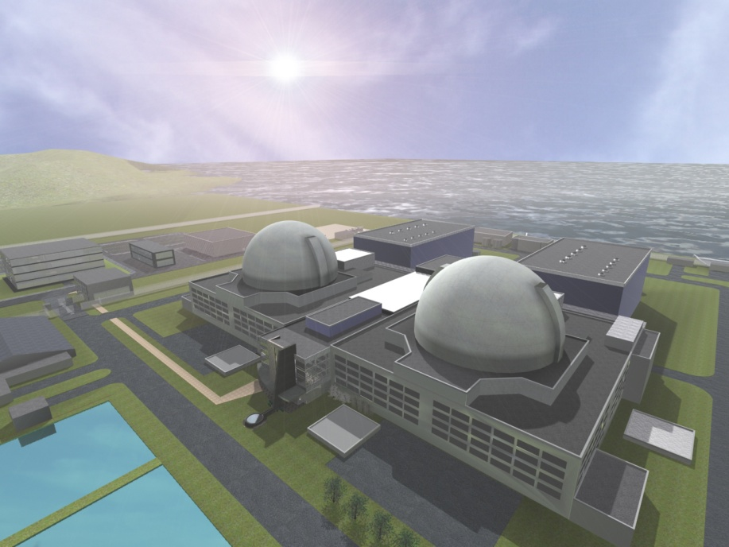
A modest design step, a large performance step
CANDU 6:
Heavy-water cooled
740 MWe class
ACR-1000:
Light-water cooled
1200 MWe class
AECL - OFFICIAL USE ONLY / À USAGE EXCLUSIF - EACL

Slide 26
Future options
Short Term
New Uranium supplies?
Deploy Uranium saving technologies
Recovered Uranium
Recovered Plutonium
Thorium
Depleted Uranium
Mixed Oxides
Actinide Waste
Long Term: 2050+
Develop Gen IV reactors
CANDU CAN UTILIZE THEM ALL
AECL - OFFICIAL USE ONLY / À USAGE EXCLUSIF - EACL

Slide 27
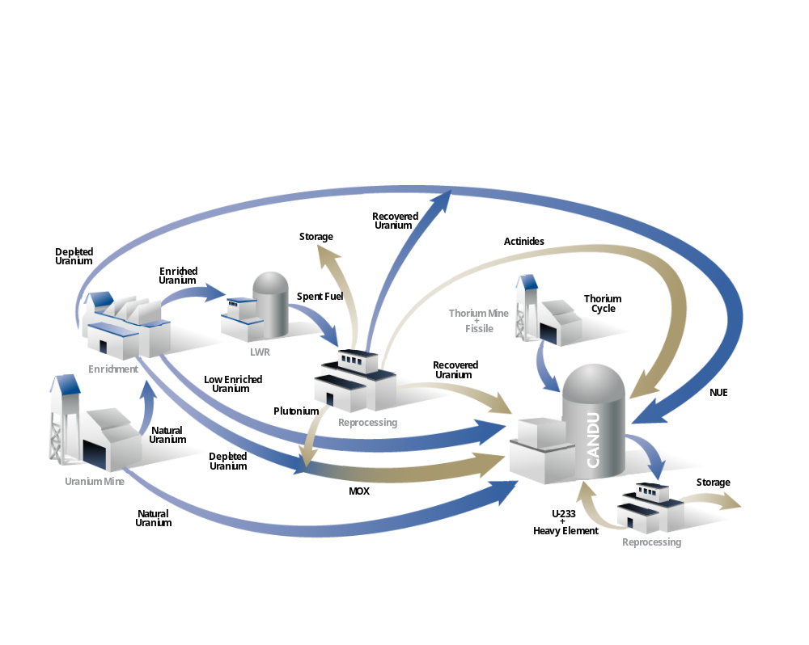
CANDU advanced fuel cycles
Current
focus areas
AECL - OFFICIAL USE ONLY / À USAGE EXCLUSIF - EACL

Slide 28
Summary
Fukushima is an extraordinary event that will leave its impact on the nuclear industry in the form of lessons learned and new safety improvements;
With a few exceptions the use of nuclear power to general electricity will continue (but with some delays);
The key factor that will affect nuclear’s future will be economics (China and India will be leaders);
Over the next few years subsidies to renewables will be significantly reduced and the playing field will be leveled;
Nuclear will continue to be a key player.

Slide 29

AECL Bucharest Office,
95-99 Polona Street,
Floor 2, Sector 1
010496 Bucharest – Romania
Tel: +40 21 410 44 60
Fax: +40 21 410 55 57
AECL Branch Office Cernavoda,
6, Medgidiei St.
905200 Cernavoda – Romania
www.aecl.ca
Tel: +40 241 239 031
Fax: +40 241 235 085

